Slide 1
Chapter 3 Objectives
The CCNA Topics Covered in this chapter include:
  Types of Dynamic Routing Protocols
  Distance vector routing concepts
  Routing loop problem in distance vector
  Solutions to solve the routing loop problem
  How RIP works ?
  Configuration and verification of RIP
  How IGRP works?
  Configuration and verification of IGRP

Slide 2
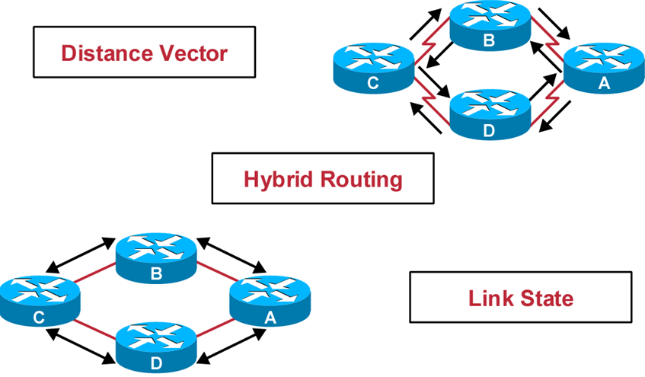
Types of Routing Protocols

Slide 3
Types of Routing Protocols
Distance Vector
  RIP V1
  IGRP
  RIP V2
Link state
  OSPF
Hybrid
  EIGRP

Slide 4
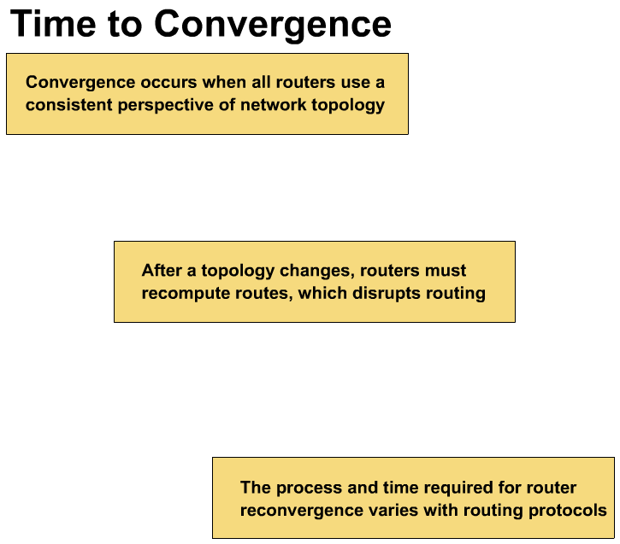
When all routers in an internetwork are operating with the same knowledge, the internetwork is said to have converged.
Fast convergence is a desirable network feature because it reduces the period of time in which routers would continue to make incorrect/wasteful routing decisions.

Slide 5

Distance Vector
Distance—How far
Vector—In which direction
D
C
B
A
Routing
Table
Routing
Table
Routing
Table
Routing
Table
All routers just broadcast their entire routing table out all active interfaces on periodic time intervals.

Slide 6
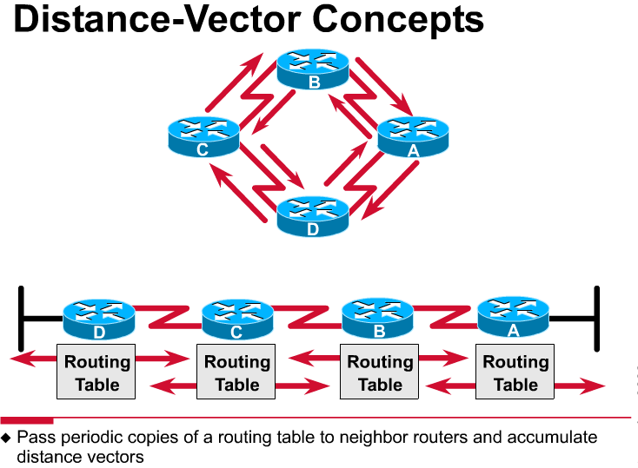
172.16.0.0/16
Network Discovery and Routing Table Maintenance
Distance-vector-based routing algorithms pass periodic copies of a routing table between adjacent routers, from router to router. (RIP every 30 seconds, IGRP every 90 seconds).
These regular updates between routers help routers discover each other’s networks and communicate topology changes.
Routers only learn about other networks from adjacent routers, their directly connected neighbors.
Router D learned about Router A’s network 172.16.0.0/16 from Router C, who learned it from Router B, who learned it from Router A.
This is why distance-vector routing protocols are also known as routing by rumor.

Slide 7
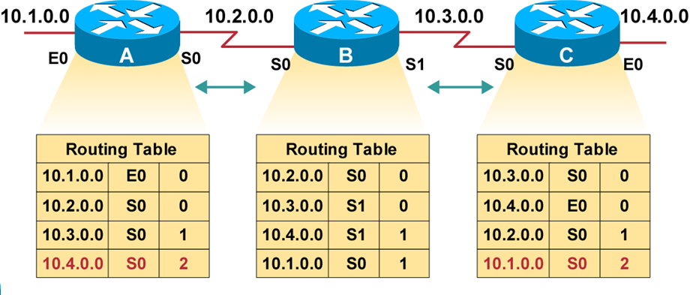
Discovering Routes
Distance-vector routing protocols do not allow routers to know the topology of the network, as they only know how far a network is (distance: hops) and which way to forward the packet (vector: exit interface). (Link-state routing protocols allow routers to see the exact network topology – later.)
  Distances (hops) are cumulative from one router to the next

Slide 8
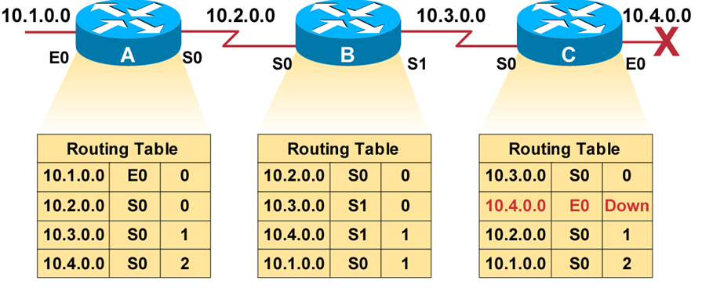
Routing Loops
Slow convergence produces inconsistent routing.

Slide 9
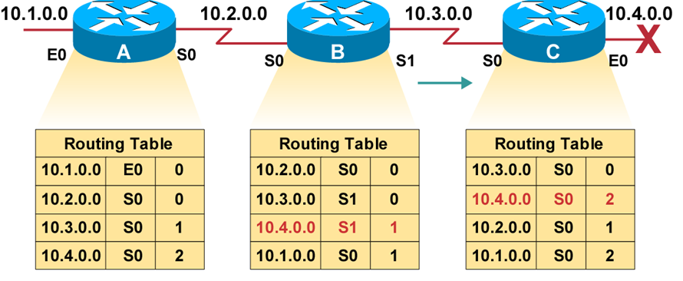
Routing Loops
Router C concludes that the best path to network 10.4.0.0 is through router B.

Slide 10
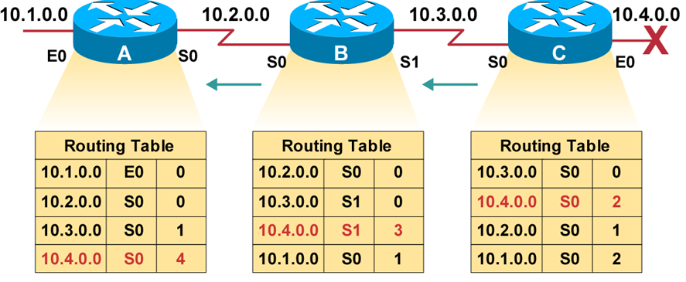
Routing Loops
Router A updates its table to reflect the new but erroneous hop count.

Slide 11
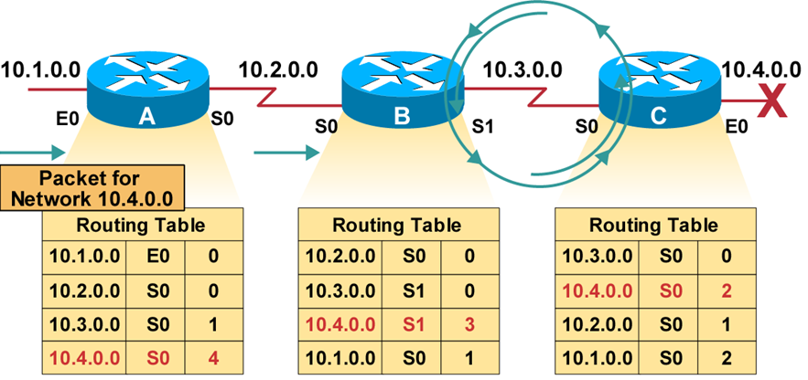
Routing Loops
Packets for network 10.4.0.0 bounce (loop) between routers B and C.

Slide 12
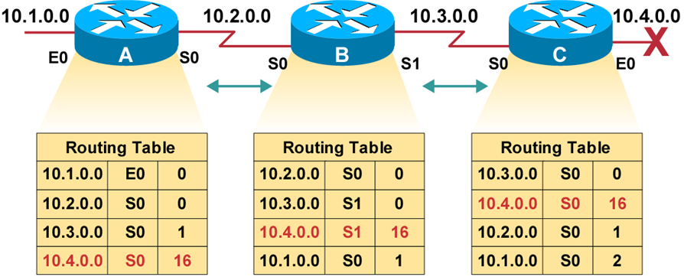
Defining a Maximum
Define a limit on the number of hops to prevent infinite loops.

Slide 13
Maximum Hop Count
One way of solving routing loop problem is to define a maximum hop count.
RIP permits a hop count of up to 15, so anything that requires 16 hops is deemed unreachable
The maximum hop count will control how long it takes for a routing table entry to become invalid

Slide 14
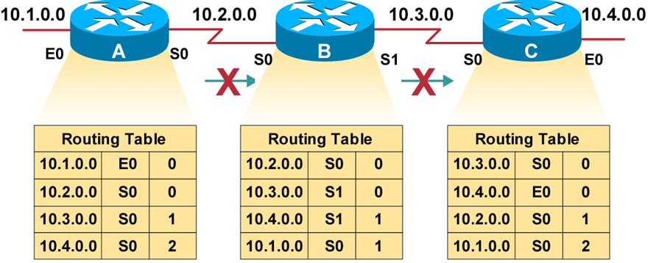
Split Horizon
Solution to the Routing Loop problem
Split Horizon is a rule that routing information cannot be sent back in the direction from which it was received
It is never useful to send information about a route back in the direction from which the original information came.
Had split horizon been used in our example, Router B would not have included information about network 10.4.0.0 in its update to Router C.

Slide 15
Route Poisoning
Route Poisoning. Usually used in conjunction with split horizon
Route poisoning involves explicitly poisoning a routing table entry for an unreachable network
Once Router C learned that network 10.4.0.0 was unavailable it would have immediately poisoned the route to that network by setting its hop count to the routing protocol’s infinity value

Slide 16
Triggered Updates
New routing tables are sent to neighboring routers on a regular basis.
RIP updates occur every 30 seconds
However a triggered update is sent immediately in response to some change in the routing table.
The router that detects a topology change immediately sends an update message to adjacent routers that, in turn, generate triggered updates notifying their adjacent neighbors of the change.
Triggered updates, used in conjunction with route poisoning, ensure that all routers know of failed routes.

Slide 17
Holddown Timer
Holddowns are a technique used to ensure that a route recently removed or changed is not reinstated by a routing table update from another route
Holddown prevents regular update messages from reinstating a route that is going up and down (called flapping)
Holddowns prevent routes from changing too rapidly by allowing time for either the downed route to come back up
Holddowns make a router wait a period of time before accepting an update for a network whose status or metric has recently changed

Slide 18
Routing Information Protocol (RIP)
Routing Information Protocol (RIP) is a true distance-vector routing protocol.
It sends the complete routing table out to all active interfaces every 30 seconds
RIP only uses hop count to determine the best way to a remote network
It has a maximum allowable hop count of 15
AD is 120
Bellman-ford algorithm
Works well in small networks, but it’s inefficient on large networks
RIP version 1 uses only classful routing, which means that all devices in the network must use the same subnet mask
RIP version 2 does send subnet mask information with the route updates. This is called classless routing.

Slide 19
RIP Configuration
The router command starts a routing process.
The network command is required because it enables the routing process to determine which interfaces participate in the sending and receiving of routing updates.
An example of a routing configuration is:
Gates(config)#router rip
Gates(config-router)#network 172.16.0.0
The network numbers are based on the network class addresses, not subnet addresses or individual host addresses.

Slide 20

RIP Configuration
R1
R2
R3
192.168.20.1
192.168.30.1
S0
S0
S1
192.168.10.1
E0
S0
192.168.30.2
E0
192.168.40.1
192.168.20.2
R2# config t
R2(config)#router rip
R2(config)#network 192.168.20.0
R2(config)#network 192.168.30.0
A
B
192.168.40.2
R1# config t
R1(config)# )#router rip
R1(config)#network 192.168.10.0
R1(config)#network 192.168.20.0
R3# config t
R3(config)# )#router rip
R3(config)#network 192.168.30.0
R3(config)#network 192.168.40.0

Slide 21
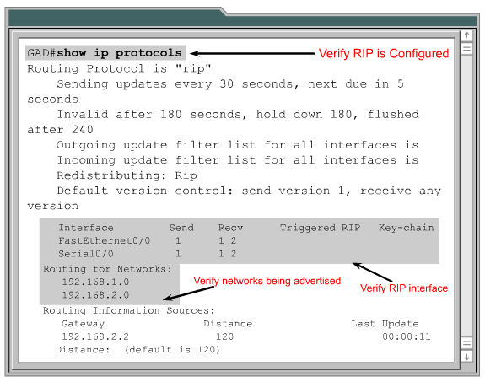
Verifying RIP Configuration

Slide 22
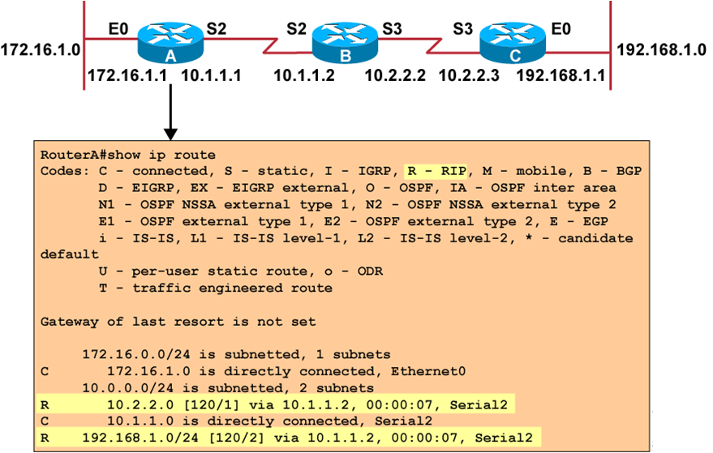

Slide 23
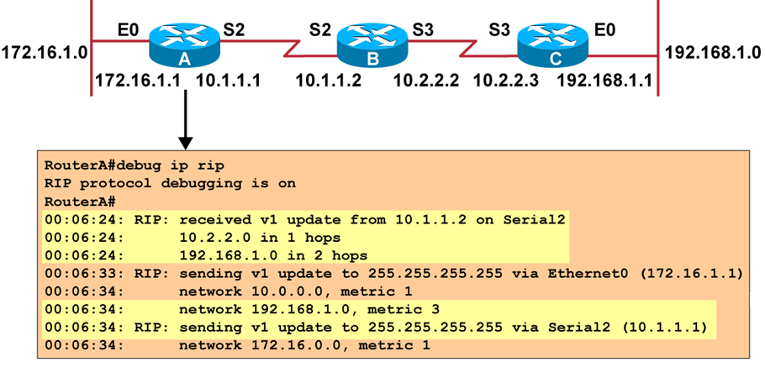
Troubleshooting RIP

Slide 24
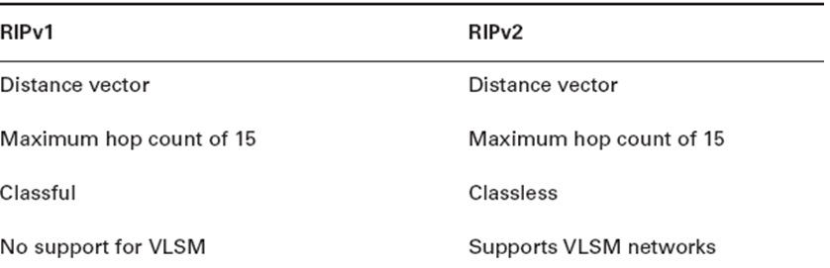
RIP Version 2 (RIPv2)
R1# config t
R1(config)# )#router rip
R1(config)#network 192.168.10.0
R1(config)#network 192.168.20.0
R1(config)#version 2

Slide 25
Introducing IGRP
  CISCO Proprietary
  More scalable than RIP
  Sophisticated metric
  IGRP Composite Metric
  Bandwidth
  Delay
  Reliability
  Load
  MTU

Slide 26
IGRP
Some of the IGRP key design characteristics emphasize the following:
  It is a distance vector routing protocol.
  Routing updates are broadcast every 90 seconds.
  Bandwidth, load, delay and reliability are used to create a composite metric.
  The main difference between RIP and IGRP configuration is that when you configure IGRP, you supply the autonomous system number. All routers must use the same number in order to share routing table information.

Slide 27
IGRP Configuration
R1
R2
R3
192.168.20.1
192.168.30.1
S0
S0
S1
E0
S0
192.168.30.2
E0
192.168.40.1
192.168.20.2
R2# config t
R2(config)#router igrp 10
R2(config)#network 192.168.20.0
R2(config)#network 192.168.30.0
A
B
192.168.40.2
R1# config t
R1(config)# )#router igrp 10
R1(config)#network 192.168.10.0
R1(config)#network 192.168.20.0
R3# config t
R3(config)# )#router igrp 10
R3(config)#network 192.168.30.0
R3(config)#network 192.168.40.0

Slide 28
Verifying the IGRP Routing Tables
LabA#sh ip route
[output cut]
I 192.168.50.0 [100/170420] via 192.168.20.2, Serial0/0
I 192.168.40.0 [100/160260] via 192.168.20.2, Serial0/0
I 192.168.30.0 [100/158360] via 192.168.20.2, Serial0/0
C 192.168.20.0 is directly connected Serial0/0
C 192.168.10.0 is directly connected, FastEthernet0/0
The I means IGRP-injected routes. The 100 in [100/160360] is the administrative distance of IGRP. The 160,360 is the composite metric. The lower the composite metric, the better the route.
To delete all routes
clear ip route

Slide 29
Debug Commands
debug ip igrp events Command
  summary of the IGRP routing information that is running on the network.
debug ip igrp transactions Command
  shows message requests from neighbor routers asking for an update and the broadcasts sent from your router toward that neighbor router.
no debug all – to turn off all debug

